Slide 1
Harmony Graphics Hands-On Training
12/1/2022

Slide 2

Agenda
Designing with Graphics Composer Suite
Navigating Basic Widgets and Schemes
Managing Events
Dynamic Strings
Animations

Slide 3
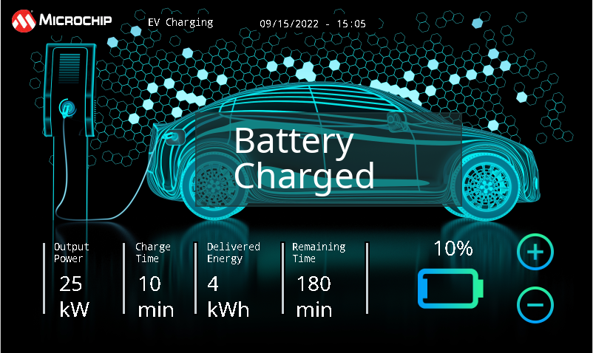
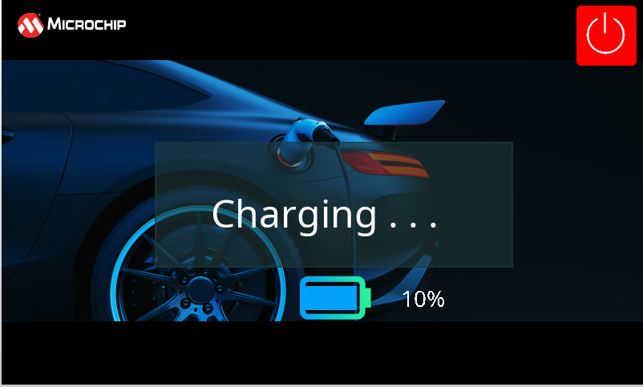

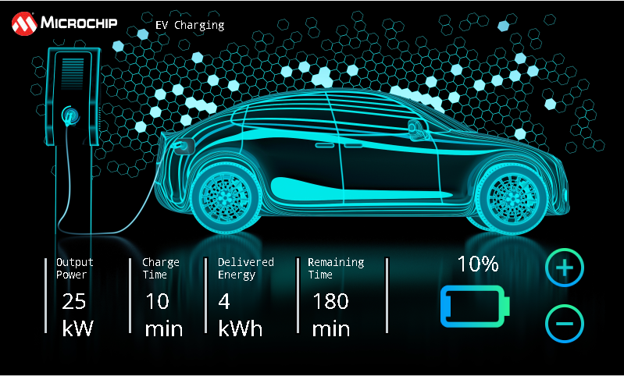
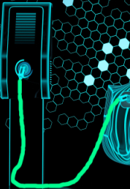
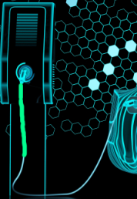
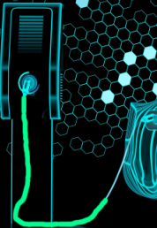
Application Design

Slide 4
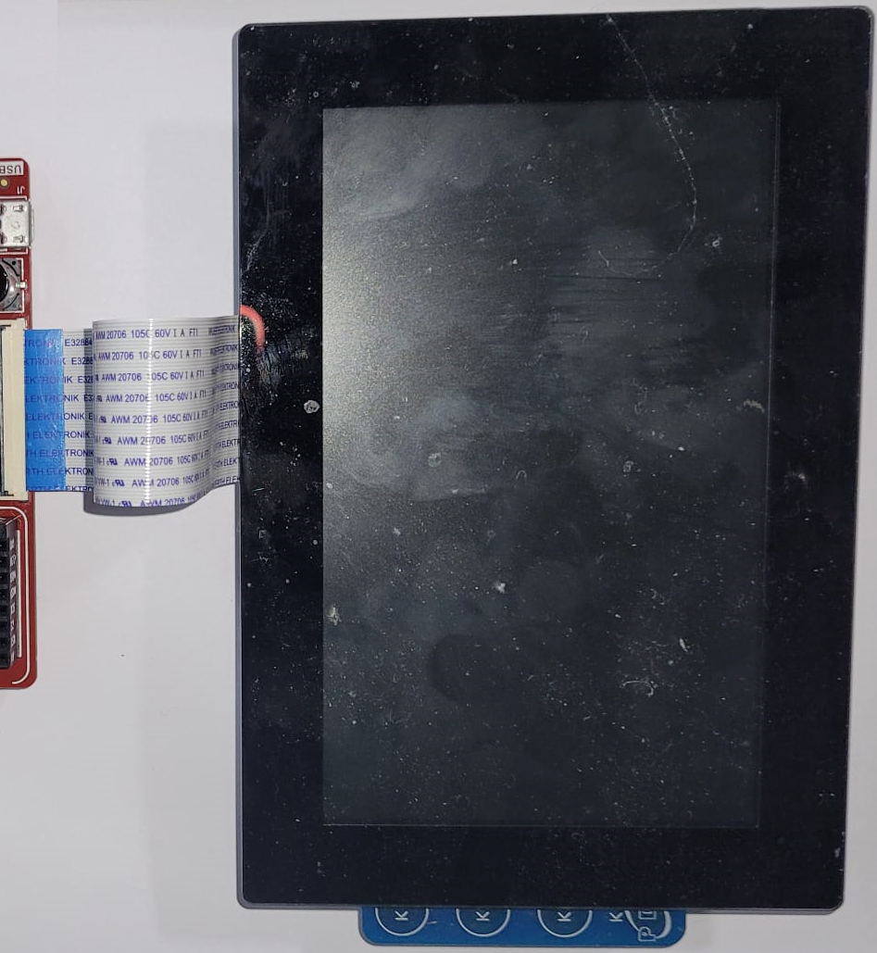
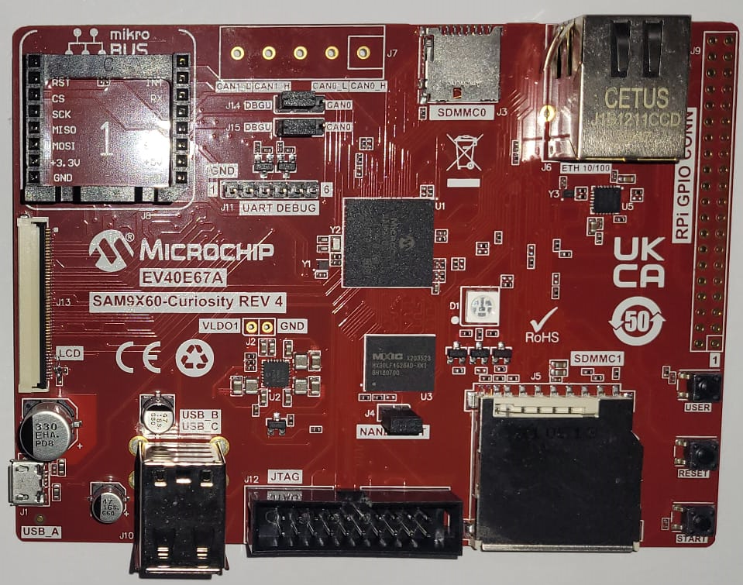
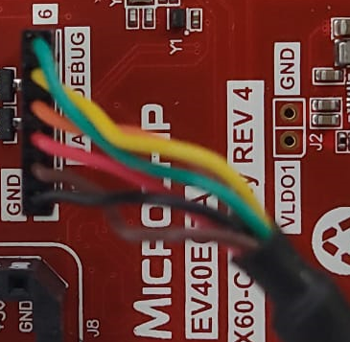

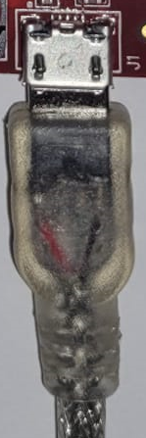
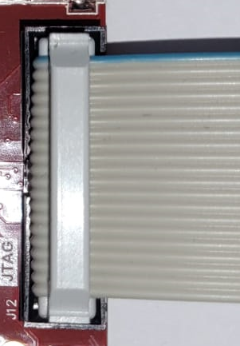
Hardware Requirement
WVGA Display Module
SAM9X60 Curiosity
FTDI Cable
USB for power
JTAG Debugger

Slide 5
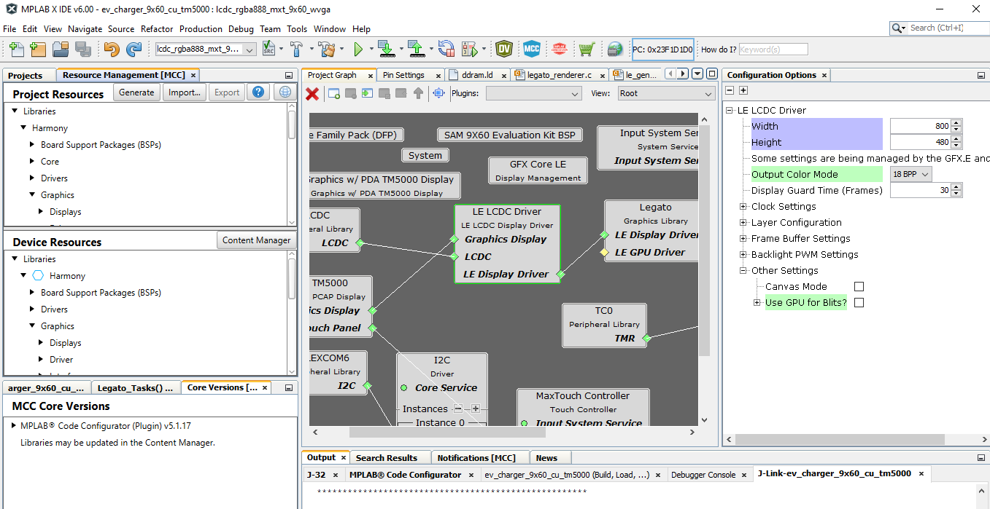
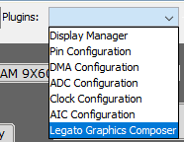
MPLAB® Code Configurator
Code Generation
Config Options
Components
Configured using MGC
Project Graph
Notes:
Configurator – same one as in Harmony training.
But now here you see the graphics components, Displays, Drivers, Processor, Templates.

Slide 6
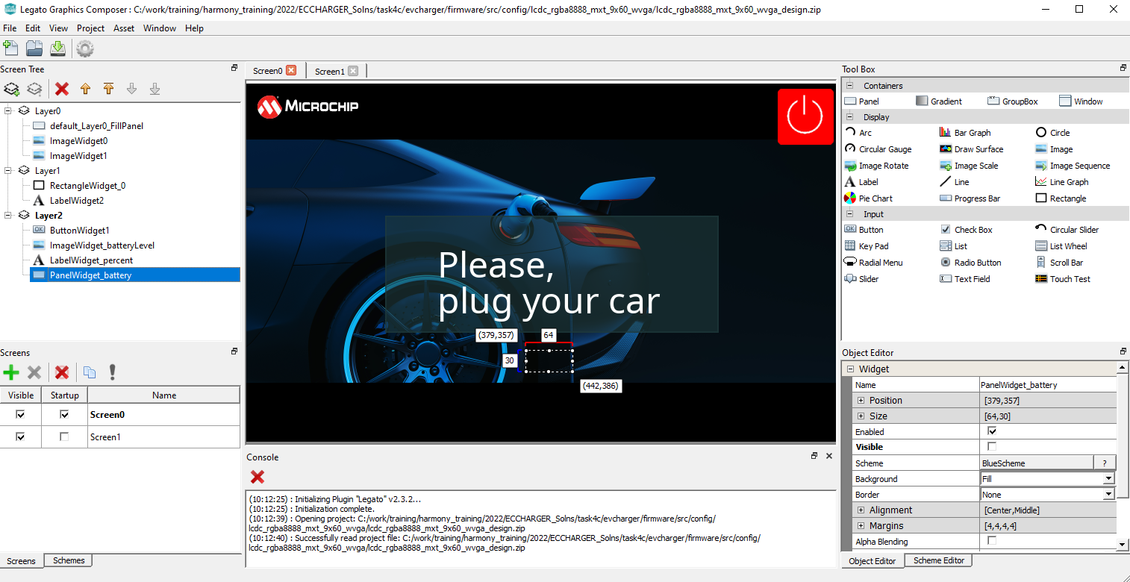
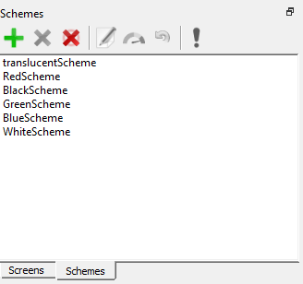
Microchip Graphics Composer (MGC)
Screen Designer
Widgets Tool Box
Design Tree View
Object Editor
Screen manager
Schemes manager
Notes:
Designer and it’s main parts. Go thru them with basic description, will discuss in detail later.
Summary: Inclusive development environment that lets you design the graphical UI.

Slide 7
Task 1
Create an MCC project from Scratch
Using MHC create a design
Using Asset Manager add: Images, Font, String
Add Image, Label and Button Widgets
Add/ Modify Schemes

Slide 8
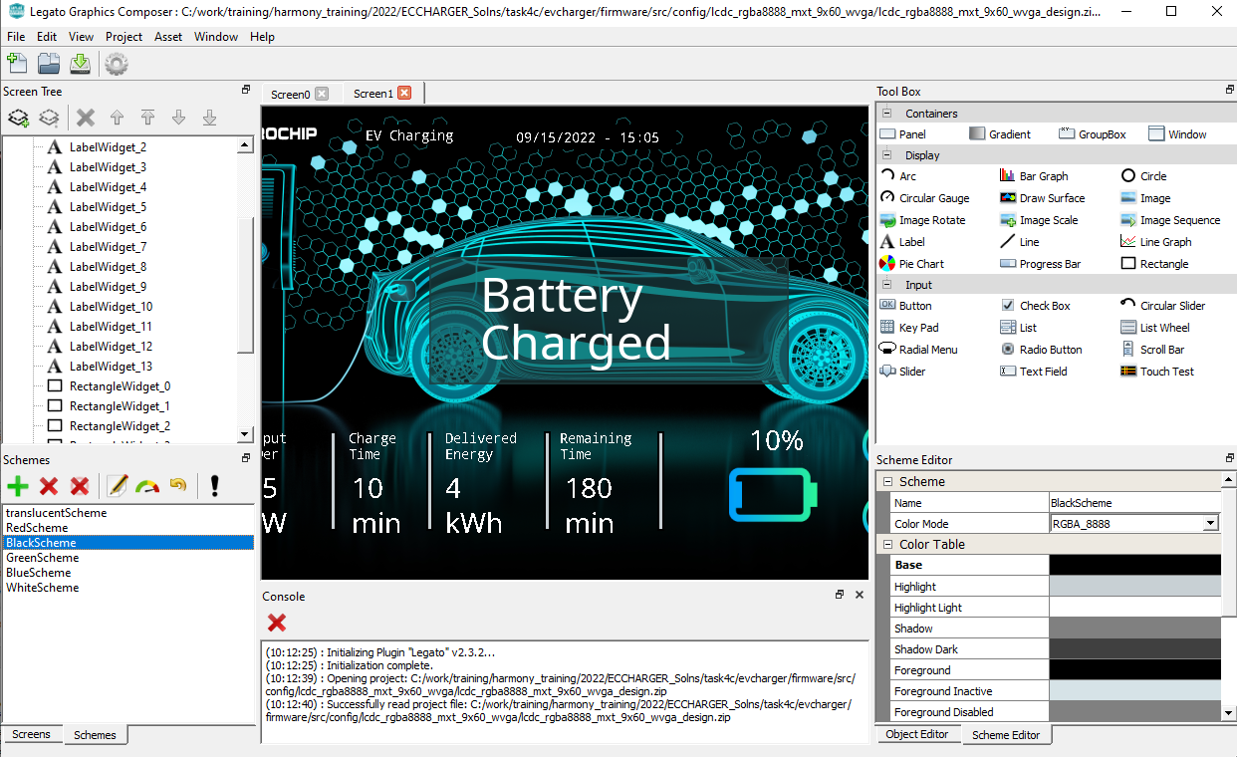
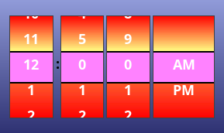
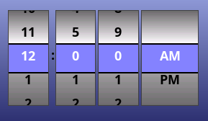
Color Schemes
A color scheme is an arrangement of colors used to draw various parts of a widget
Provides variability in look-and-feel
Transparent Scheme
Scheme Editor
Scheme List

Slide 9
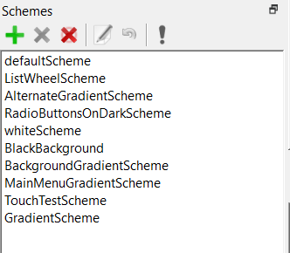
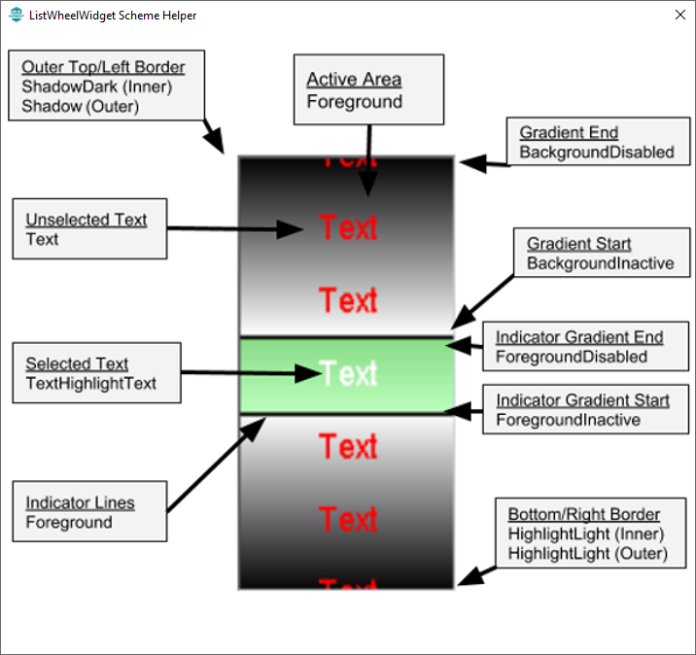
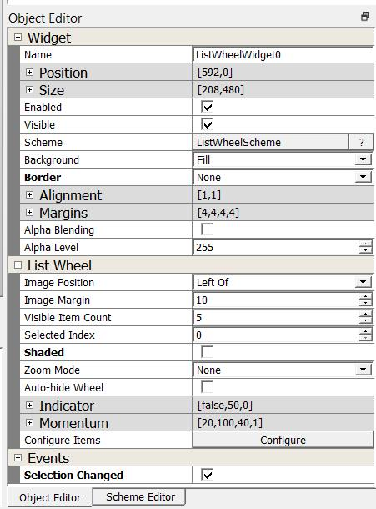
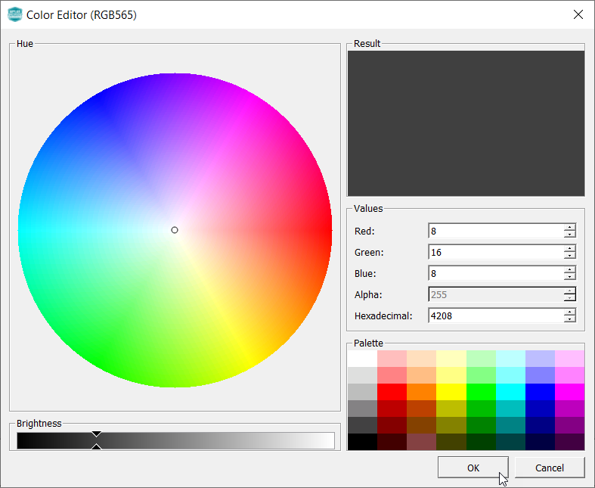
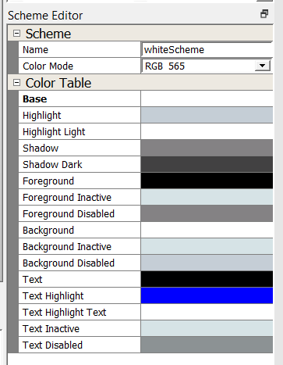
Scheme Management
Scheme Manager
Scheme Helper
Scheme Color Picker
Scheme Editor
Alpha value adds transparency

Slide 10
Task 2
Understanding HW Overlays & Multi-Layers
Handling Events
Button Press Event
Screen Transition

Slide 11
Hardware Compositing
Integrated Controller HW Overlays
Frame Buffers
Output Frame
Graphics Library
Display Controller
Hello World
Hello World
HW Overlays
The LCD Controller in Microchip MPUs have multiple hardware overlays
The graphics library renders to a frame buffer for each HW overlay
The display controller composites the overlays into a single frame.
Dynamic content with minimal load on the CPU, and no GPU needed.

Slide 12
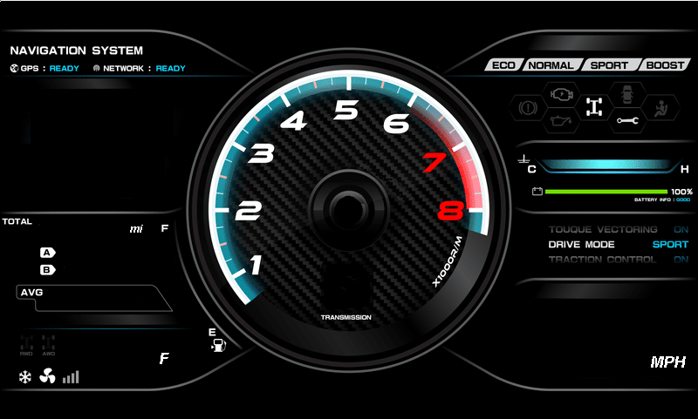
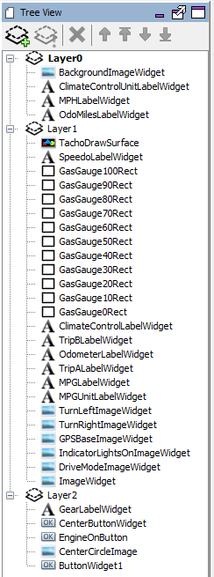
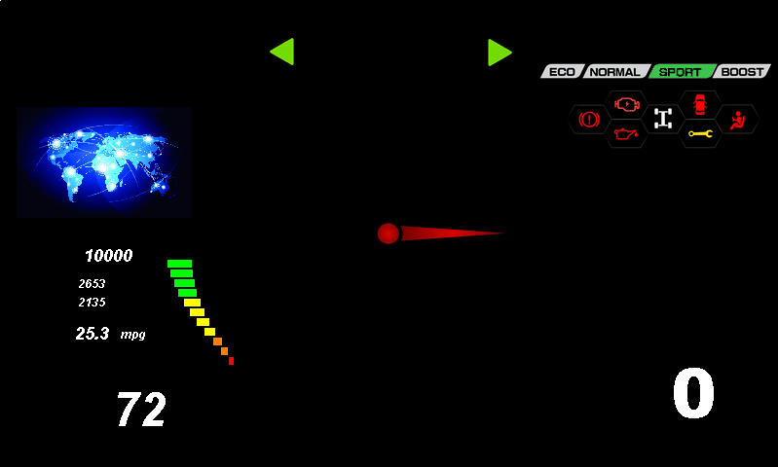
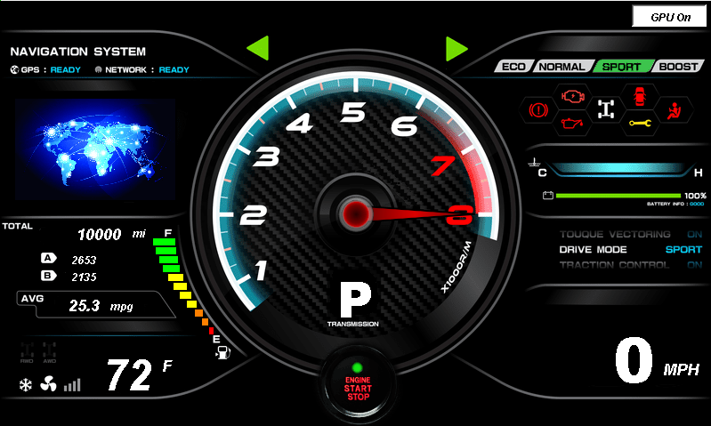
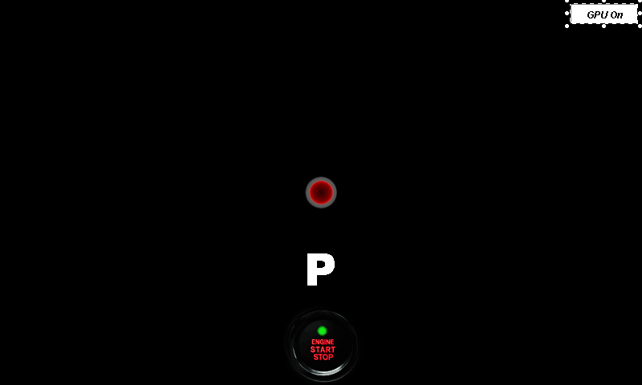
Pro Tip: Use Layers to Overlay Dynamic Content
Best Practices
Static background, drawn once
Can use compressed background images
Save space without sacrificing performance
Use middle layer for non-interactive, dynamic content
Show dynamic content without redrawing background
Use top layer for interactive UI controls and static overlays
User input is instantly captured
Minimize redraw of controls
Less redraw = better performance

Slide 13
Events Handling
Graphics Library
Screen Change
Touch Input
Property Change
Screen Event
Widget Event
Event Callbacks
What can callbacks do?
Widget Event Callbacks
Call library functions to update the UI
Call driver or PLIB functions to control hardware
Call app functions to perform business logic
Screen Event Callbacks
On Hide
Pressed
On Show
Released
On Update
Other
Event Callbacks
Library Functions
Driver or PLIB Functions
Application Functions

Slide 14
Task 3
Handling Dynamic Strings
Using RTC

Slide 15

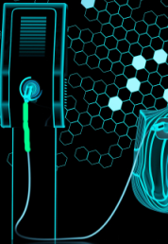
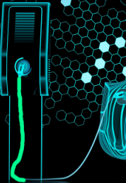
Task 4
Animation using Graphics Canvas

Slide 16
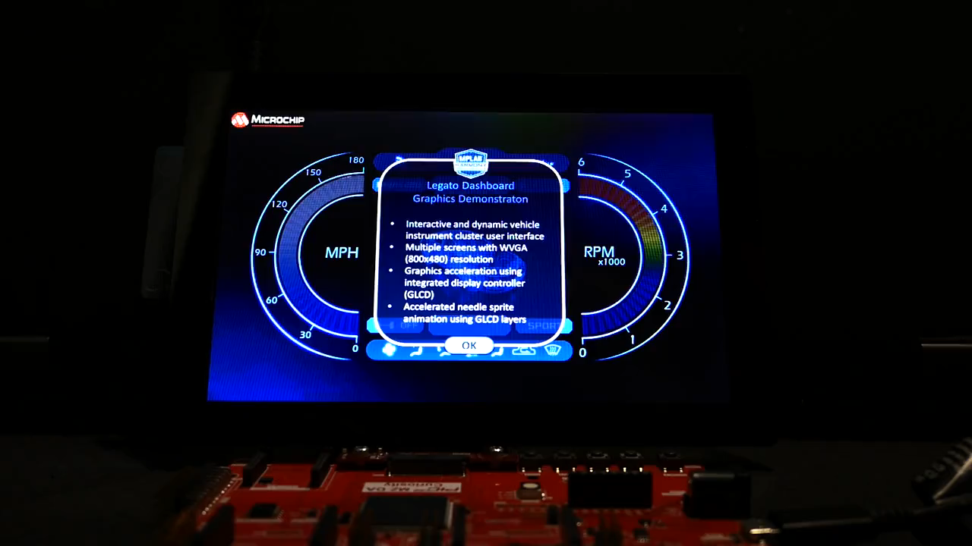
What is the Graphics Canvas?
Virtual Display
Legato Library
Application
A ‘Virtual Display’ software layer for
Storing or pre-rendering Frame with the GFX Library
Configuring the Display Controller Layers to display the Frames
Applying effects like Motion, Sliding Panels, Sprite Animation, Cropping, Screen Transitions and Fade In/Out using Display Controller Layers
Frame data
Interface Functions
GFX
Canvas
Canvas
Object 1
Canvas
Object 2
Display Driver IOCTL
Canvas
Object 3
Frame Buffer
Display Driver
Display Controller
PLIB
Display Controller

Slide 17
Canvas Object
Graphics Canvas
A Canvas Object contains frame information
Buffer address, resolution, color mode
Layer ID, size, position, alpha
Layer effects status and settings
A Canvas Object is assigned a HW Layer in the Display Controller
Application calls Canvas APIs to set Display and Effects settings
Application
GFX
Canvas
Display
Controller
Canvas
Object
HW Layer

Slide 18
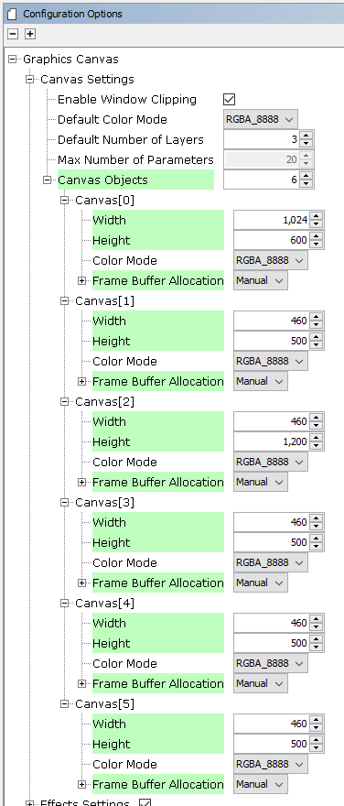
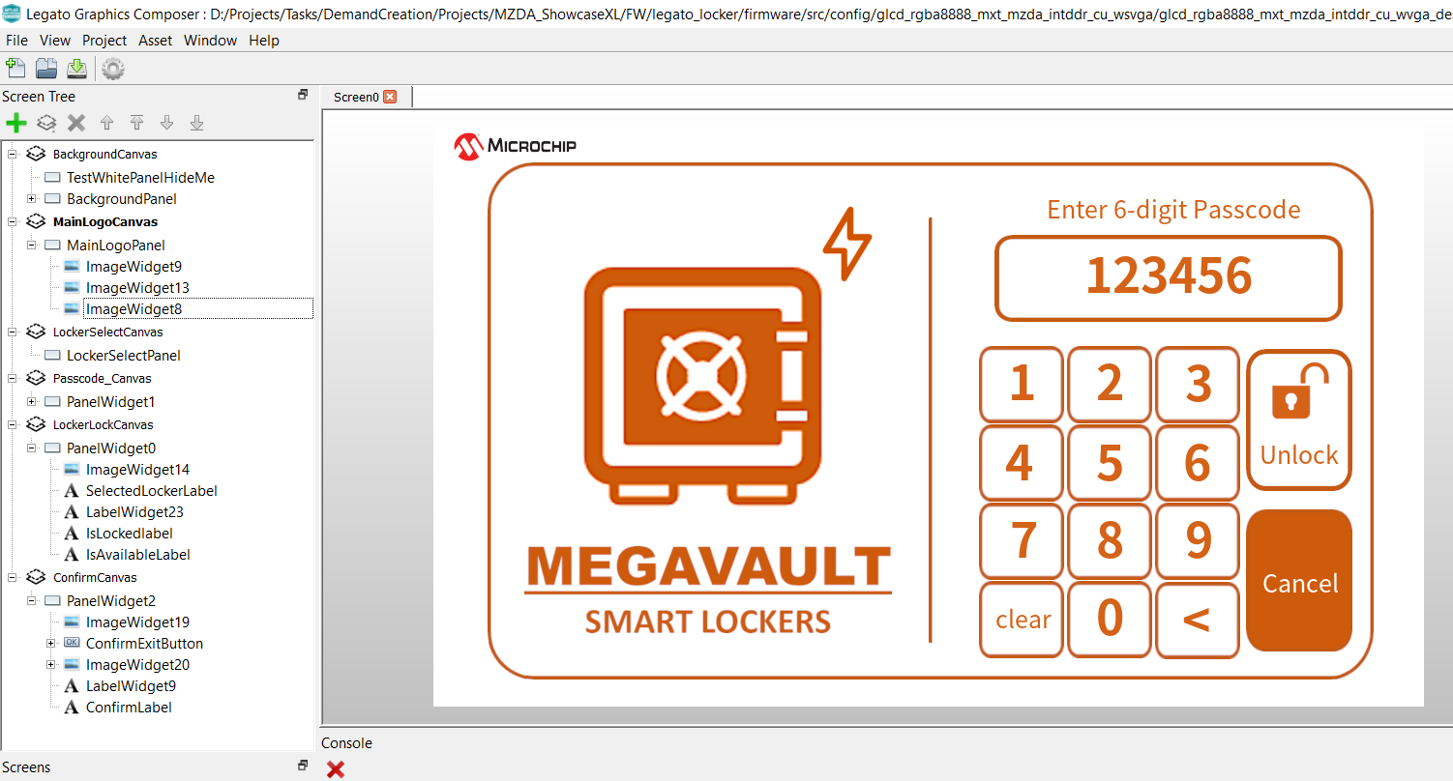
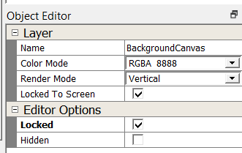
Composer and Canvas Integration
Graphics Canvas
Each composer Layer is mapped and rendered to a Canvas object at the same z-order**
# Canvas Objects > HW overlays
Allows as many layers/canvas as RAM can support!!!
Pro Tip
Use Layer Editor Options to Hide/Show Layers in the Composer Editor Window

Slide 19
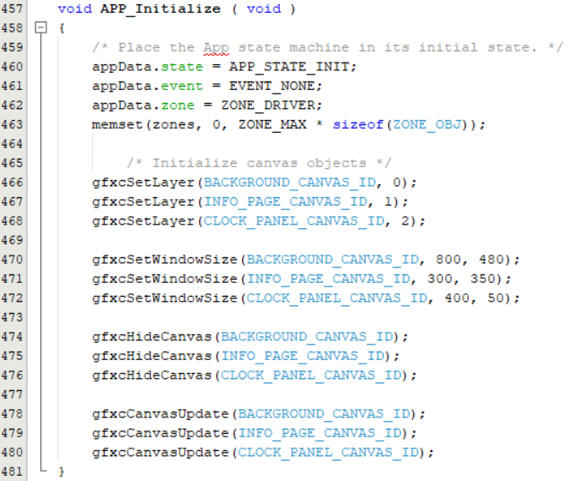
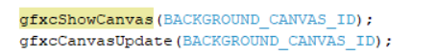
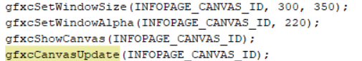
Application Interface
Using the GFX Canvas
gfx_canvas.c/h – Core module, private functions, glue code to library and display controller driver
gfx_canvas_api.c/h – Public module, interface functions
During Initialization *
At Run-time **
Set a Canvas property (Show)
Set multiple Canvas properties
Assign HW Layers to Canvas Objects
Set Canvas Window Size
Hide (or Show) Frames at Init
*legato_climate_control, **legato_dashboard
Apply Canvas Settings. HW Layer changes are applied in next VBLANK Period

Slide 20
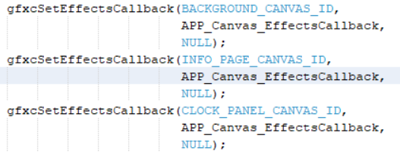
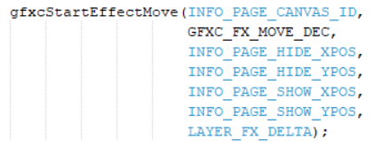
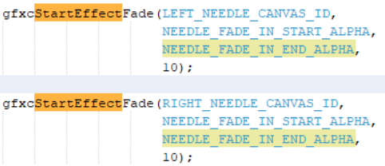
Application Interface
Adding Effects
Canvas supports Move and Fade effects***
During Initialization *
Start a Move Effect *
Application can register callbacks to be notified of the Effects Status for each Canvas Object
Move a Canvas Object with speed up/down/fixed motion, start/end positions, move steps.
Start a Fade Effect **
Fade a Canvas Object (in Layer 1), with start/end Alpha value, step value
Fade another Canvas Object (in Layer 2), with start/end Alpha value, step value
*legato_climate_control, **legato_dashboard, ***HW overlay dependent

Slide 21
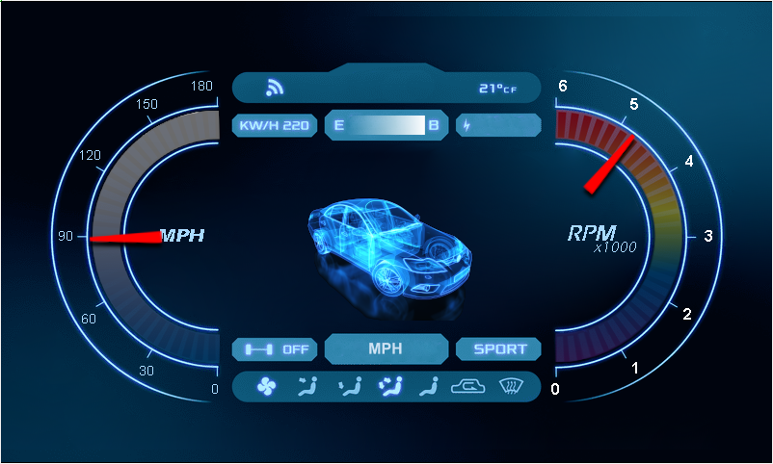
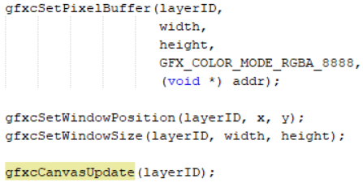





Canvas Applications
Angle | Address | Size | Position
0 | 0x80012070 | 83 * 23 | (627,238)
2 | 0x800120a8 | 86 * 24 | (626, 235)
…
N | 0x80012118 | 87 * 33 | (623, 191)
Application Code
Sprite Animation
GFX Canvas can be used to do sprite animation of multiple RAW images in memory
Images must have the same color mode as Canvas Object
A HW layer is assigned to the Canvas Object
The Pixel Buffer for the Canvas Object is updated to the address of the current image to be shown
Graphics Canvas
HW Layer
Set the pixel buffer for the canvas, based on needle image address and size in DDR
RAW Images in DDR (RGBA8888)
Set Window based on needle image position and size
Apply the Canvas settings
**legato_dashboard

Slide 22
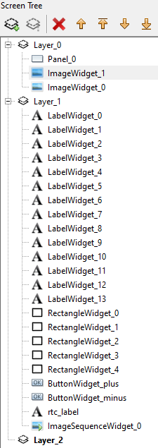
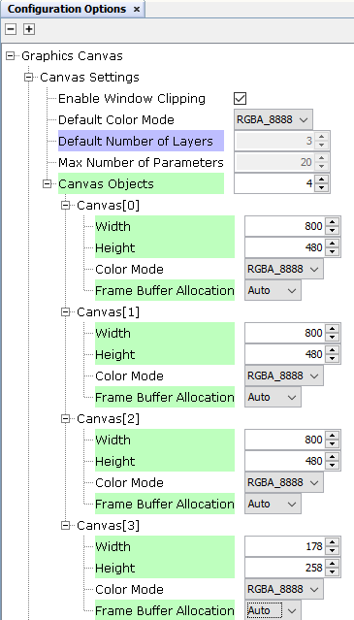

Task 4 - Implementation
[…]
14 images
Use Raw Uncompressed Images!
800
58x112
480
258
178
Canvas for Sprite

Slide 23
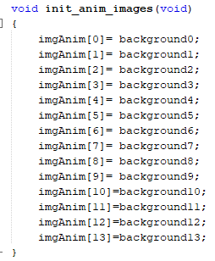
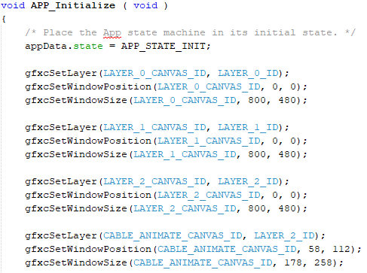
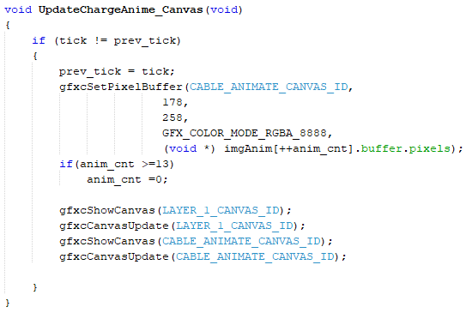
Task 4 - Implementation
2
Declaring array
Of sprite images
1
Assign Canvas Object 0 to HW Layer 0, Setting Position and size
Assign Canvas Object 1 to HW Layer 1, Setting Position and size
Assign Canvas Object 2 to HW Layer 2, Setting Position and size
3
Assign Canvas Object 3 to HW Layer 2 for sprite, Setting Position and size
Setting the next sprite image in the array to the required pixel location
Showing the updated Canvas

Slide 24


Task 5-6
Animation using Image Sequence Widget
Image sequence widget cycles through series of images
Animation using panel widget setWidth API

Slide 25
Important Resources
MGC Suite Wiki: https://github.com/mchpgfx/legato.docs/wiki
Previous Harmony Graphics trainings: https://microchiptechnology.sharepoint.com/sites/HumanInterface/SitePages/Legato-Graphics-Workshop-Series.aspx
Contact Kristy Seymour to gain access to sharepoint Link
Contains Basic and Advance trainings including recordings of the presentations

Slide 26


Questions?
Notes:
5.5 hours in (END)

Slide 27
Thank You

